Slide 1
Config Management and Containers
Charles Butler
Fosdem 2016

Slide 2
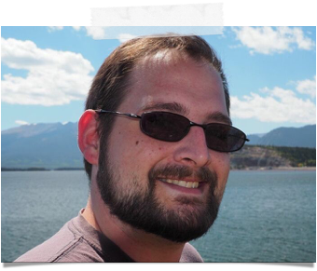
@lazypower
charles.butler@ubuntu.com
http://blog.dasroot.net
http://github.com/chuckbutler

Slide 4

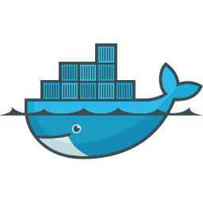
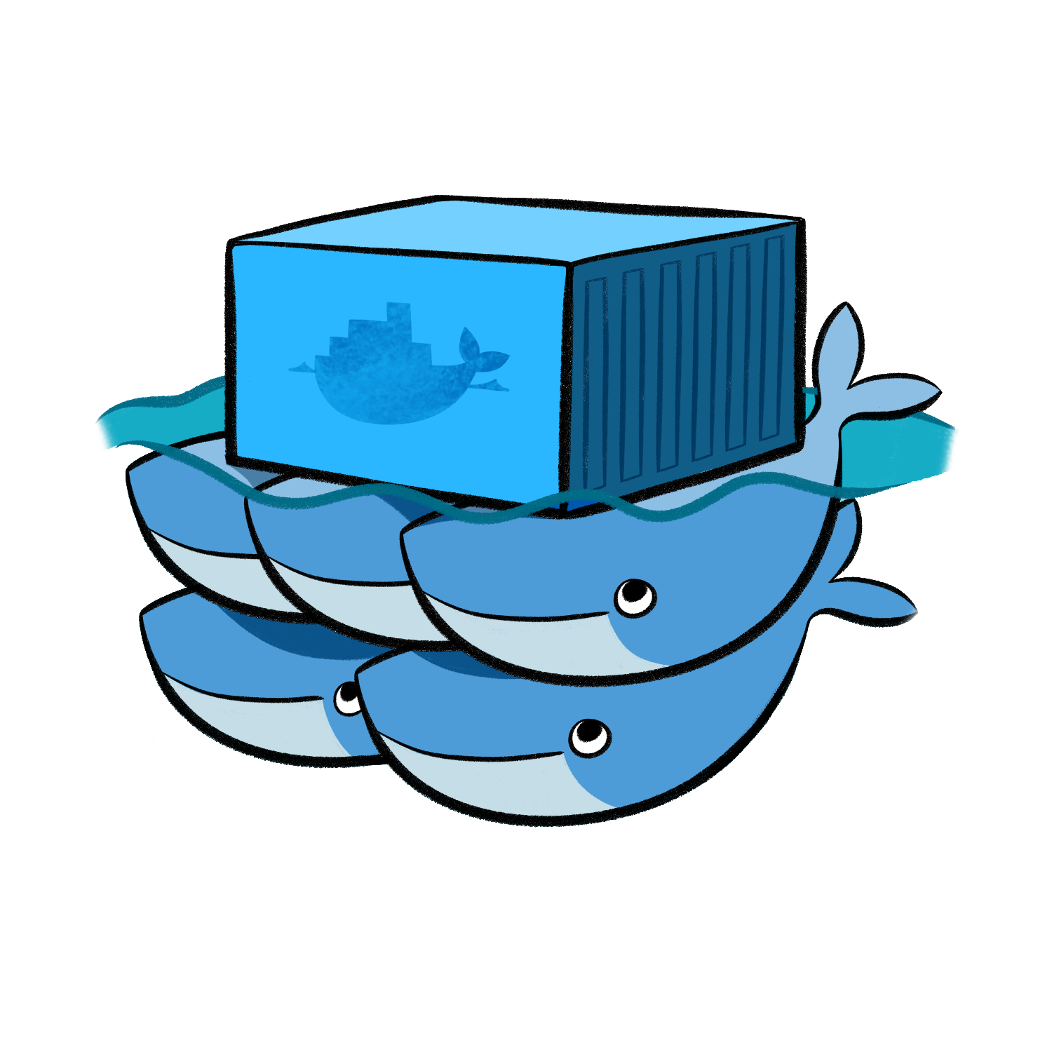



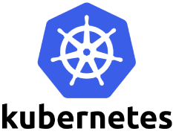

Slide 5
Genesis

Slide 6
“Operational pain can neither be created nor destroyed - only moved to someone else”
Nick Galbreath
Notes:
Devops Enterprise 2015 - John Willis, Joshua Corman
Reconfiguring network routes or interfaces while communicating with the target device via those same routes or interfaces

Slide 7
Well… You can create it… :)
Joshua Corman

Slide 8
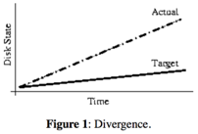
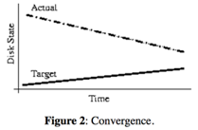
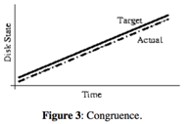
System Management Patterns
Divergence
Convergence
Congruence
cited: http://usenix.org/legacy/publications/library/proceedings/lisa02/tech/full_papers/traugott/traugott_html/index.html
Notes:
if you can completely re-deploy your entire infrastructure with a few commands, without human intervention, and resorting to tape for only user data restoration, its safe to assume your infrastructure is congruant.

Slide 9
Config Management Solved Problems
Stopped divergent delivery patterns from a pre-virtualized world
Best Attempt to eliminate snowflakes
Frameworks to describe machine state
Support upstream packaging (or from source deployments)
resource abstraction

Slide 10
Emergent issues w/ Config Management
Domain specific configuration managers
Context Sensitive Knowledge barriers.
10% technological—the rest is improved management, process, and user training. [1]
[1] cited: ftp://ftp.sei.cmu.edu/pub/case-env/config_mgt/papers/PastPresentFuture.pdf
Notes:
ambari, heat, MongoDBManagementService
DBA’s not talking to Big Data Analysts / Administrators
Only solved the tech problems, not the people problems (if only)

Slide 11
Enter Containers
The New Stack

Slide 12
Containers offer a way to virtualize an operating system.
This virtualization isolates processes, providing limited visibility and resource utilization to each, such that the processes appear to be running on separate machines.

Slide 13
Flavors
Single Process
No init
No amenities like cron
No SSH
typically run/handled as immutable objects
Many processes
runs /sbin/init
Has amenities like cron
SSH’able
Can be treated as immutable or mutable. But designed to be mutable
Application Containers
System Containers

Slide 14
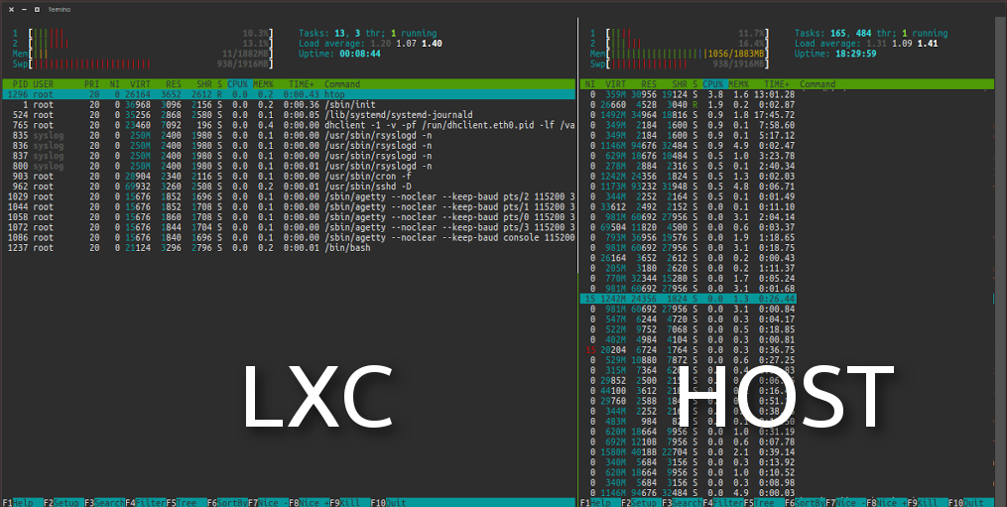
image credit: https://www.howtoforge.com/tutorial/how-to-use-docker-introduction/

Slide 15
Benefits of “the new stack”
Resource Constraints
Density
Super Fast (often sub second)
No VM Overhead

Slide 16
Why Config Management & Containers
A critical look

Slide 17

Model Everything

Slide 18
Model containers and non-containers
manage not only the containers, but the environments around the containers
This is especially important, as containerized applications are nearly always talking to components
storage
database
networking
that are not in containers, and in some (rare) cases: unable to be placed in a container.

Slide 19
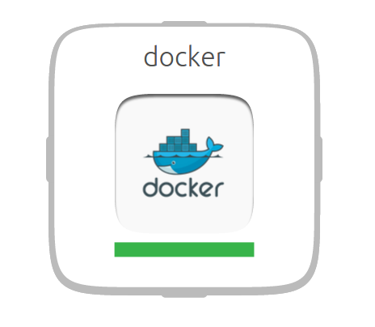
Chuck’s Adventure

Slide 20
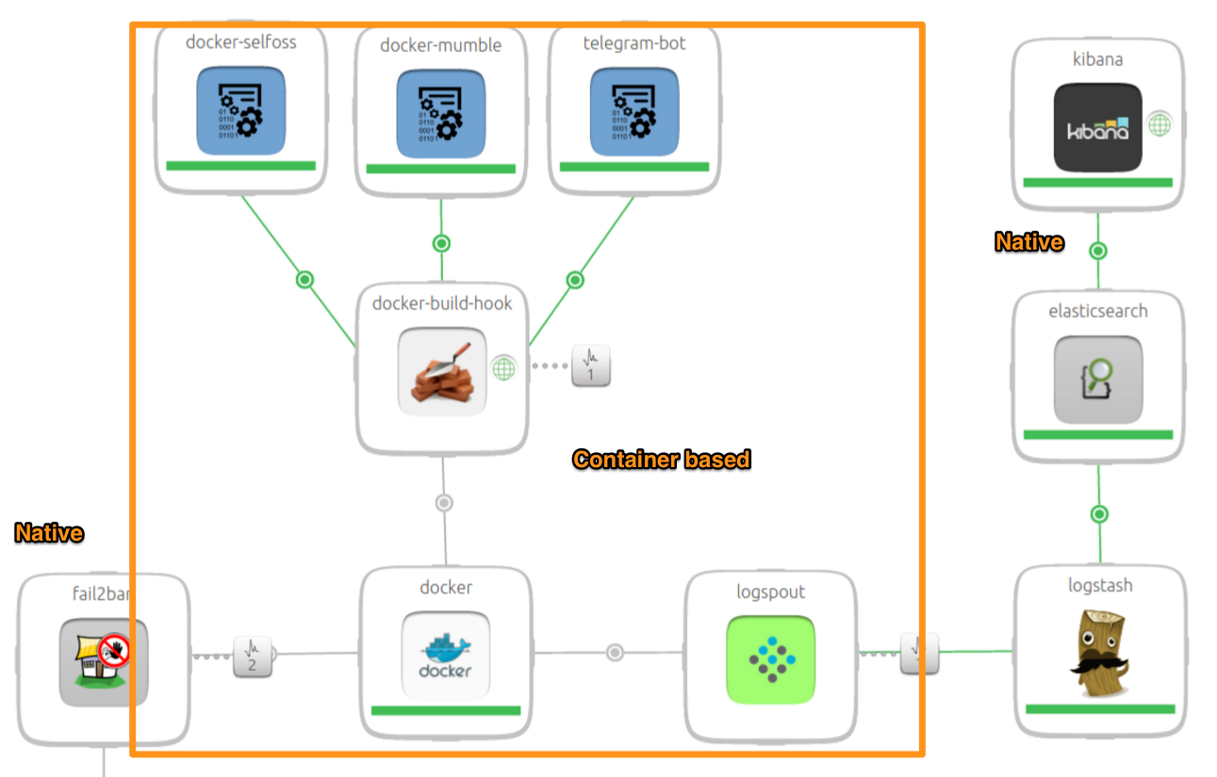
Chuck’s Adventure

Slide 21
Delivery Patterns
Application containers vs uncontained delivery

Slide 22
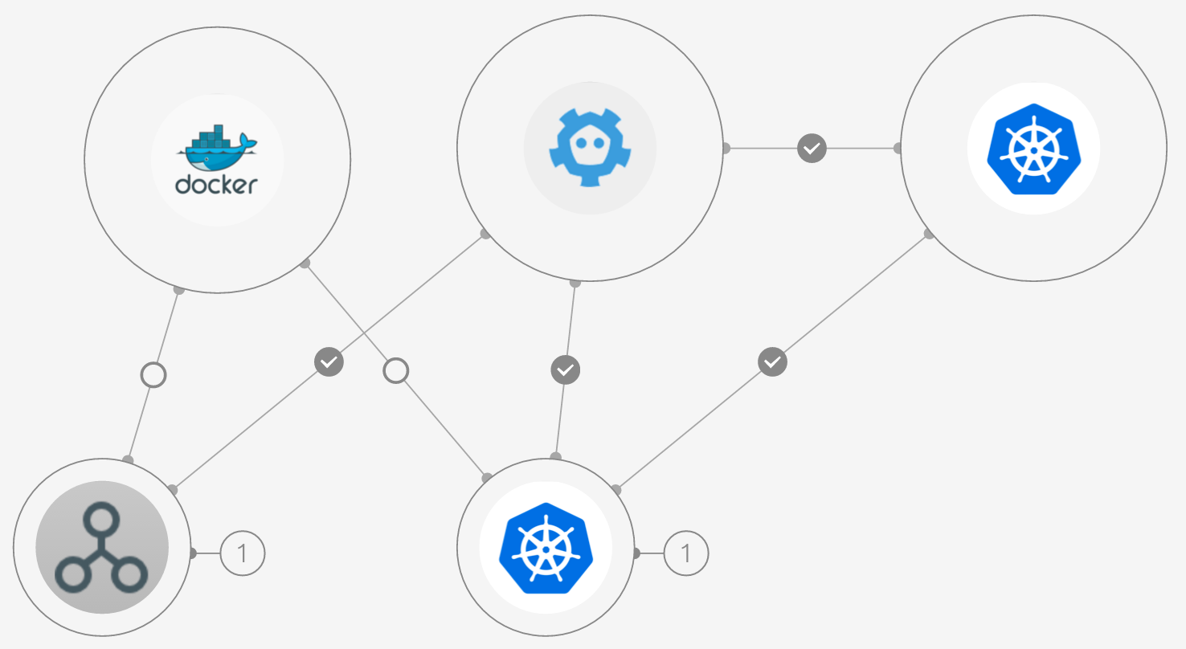
Before

Slide 23
Kubernetes Charm as a Case Study
uncontained Delivery
containerized Delivery
5317 total LOC
Required a Build Env
15 Min Delivery
8 min upgrade cycle
Different model than suggested by google
2283 total LOC
No Build Env
8 Min Delivery
~ 1 min upgrade cycle
Same model suggested by google
3,034 LOC reduction in cost of ownership

Slide 24
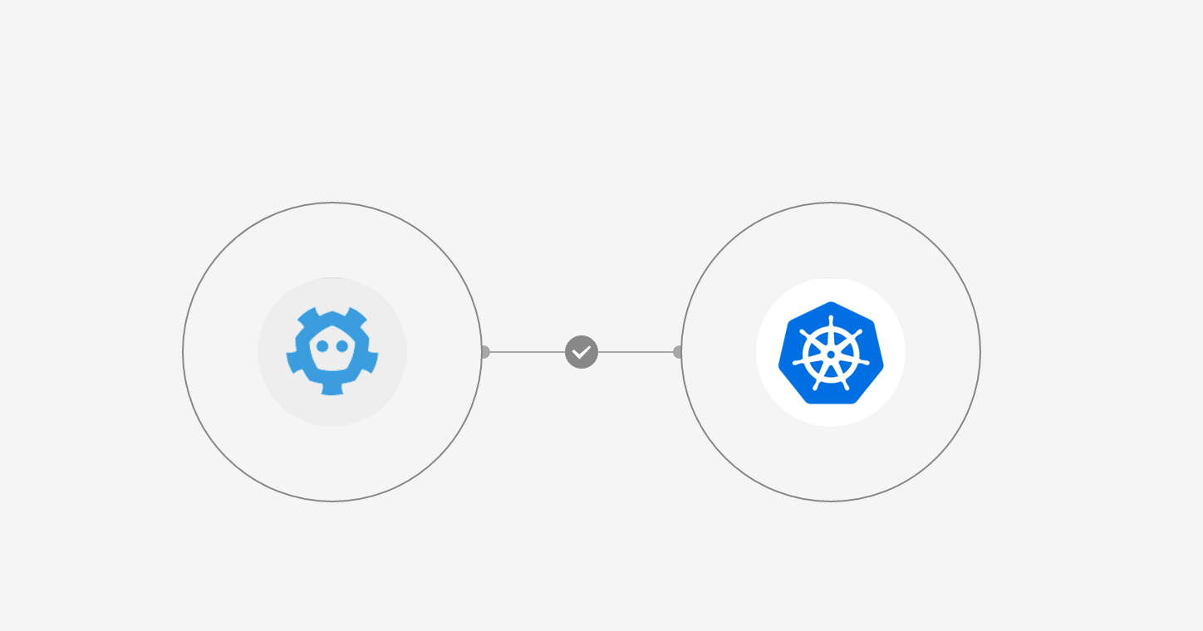
After (mid flight)

Slide 25
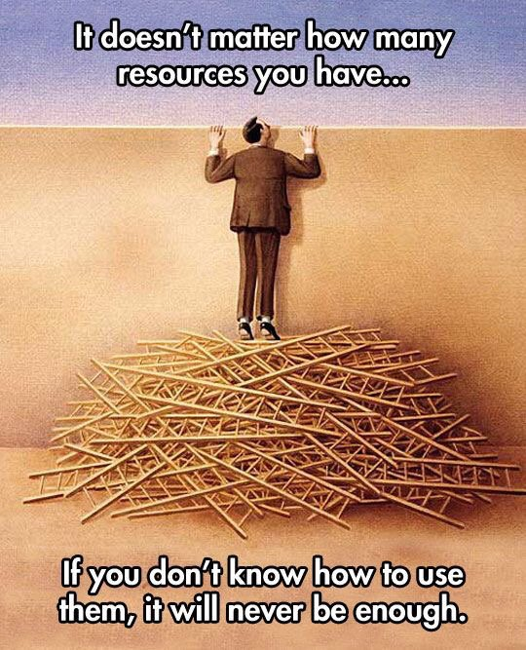

Slide 26
Take a closer look @ the
Kubernetes Example

Slide 27
layer-docker
Delivers the latest -Stable engine from Docker’s PPA
Provides a consistent interface to work with charming application containers.
meaningful synthetic states - @when(‘docker.ready’)
Includes charms.docker
http://github.com/juju-solutions/layer-docker

Slide 28
charms.docker
Configure and interact with a Docker Daemon
Manage DOCKEROPTS
opts = DockerOpts()
opts.add(‘allow-insecure-registry’, True)
opts.to_string()
http://github.com/juju-solutions/charms.docker

Slide 29
charms.docker
Interact with a docker-engine
from charms.docker import Docker d = Docker() pid = d.up('lazypower/idlerpg:latest', dirs={"files/idlerpg":"/files/idlerpg"}, ports=["8000:8000"])
http://github.com/juju-solutions/charms.docker

Slide 30
charms.docker
Manage docker-compose templates
from charms.docker.compose import Compose
compose = Compose(‘files/tikiwiki’)
compose.up(‘mysql’)
compose.kill()
compose.rm()
http://github.com/juju-solutions/charms.docker

Slide 31
Containers as Payloads

Slide 32
Containers as Payloads
System Containers can be delivered in a similar fashion
Pack in a quick-configuration script to carry your CM configuration values into the environment
lxd run /opt/configure_my_service foo=bar baz=bam
Generate the pre-configured containers with CM tooling
Juju, Chef, Puppet, Ansible, Saltstack, Foreman, CFEngine, or whatever strikes your fancy

Slide 33
LXD ships with everything you need
LXD can act as a hosting image server
Warehouse base images
Push container snapshots for migration / distribution
Trusted Registry by default, they’re all your containers

Slide 34
Where is charms.lxd then?

Slide 35
Simply stated:
LXC/LXD is natively supported in Juju. These “primitives” are exposed as a native “machine” to create units for an Application.

Slide 36
These principles work in every CM toolkit

Slide 37
Ansible Modules
https://github.com/kbrebanov/ansible-lxd
http://docs.ansible.com/ansible/lxc_container_module.html
Deliver and manage System Containers
http://docs.ansible.com/ansible/docker_module.html
Deliver and manage Application Containers

Slide 38
Chef Cookbooks
https://supermarket.chef.io/cookbooks/container
Deliver and manage System Containers
https://supermarket.chef.io/cookbooks/docker
Deliver and manage Application Containers

Slide 39
Puppet Modules
https://github.com/tripledes/sjimenez-lxc
Deliver and manage System Containers
https://forge.puppetlabs.com/garethr/docker
Deliver and manage Application Containers

Slide 40
Salt Stack
https://docs.saltstack.com/en/latest/topics/cloud/lxc.html
Create / Manage System Containers
https://docs.saltstack.com/en/latest/ref/states/all/salt.states.dockerng.html
Create / Manage Application Containers

Slide 41
Thanks for your time
Come see us @ CFGMGMTCAMP 2016 in Gent
http://summit.juju.solutions

